Slide 1
Value signals in the orbitofrontal cortex incorporate reference-dependent news utility
Brenden Eum *slides
Zeynep Enkavi
John O’Doherty
Antonio Rangel

Slide 2
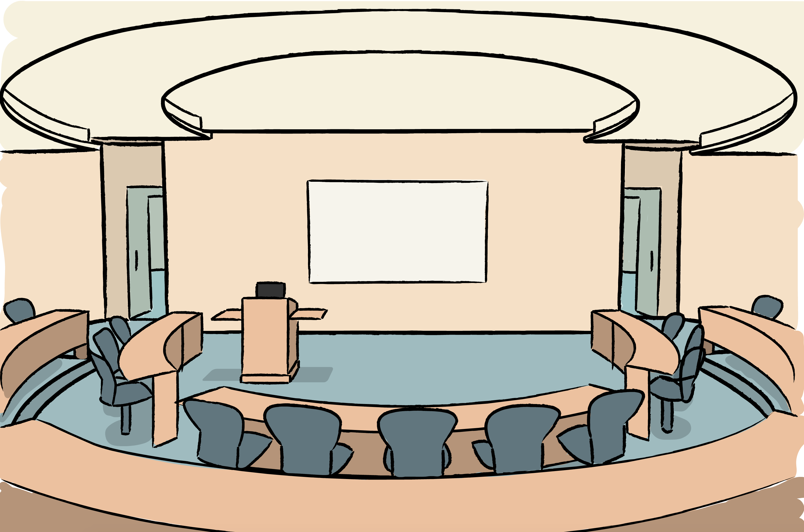
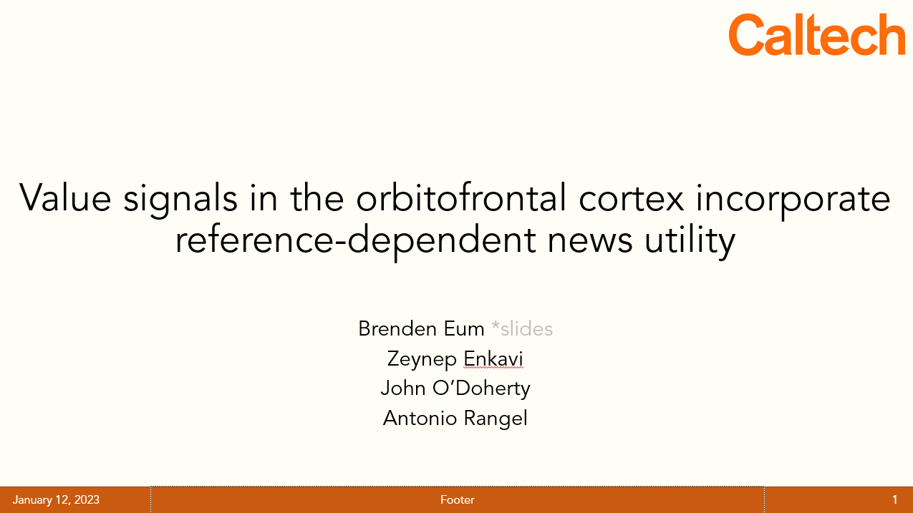

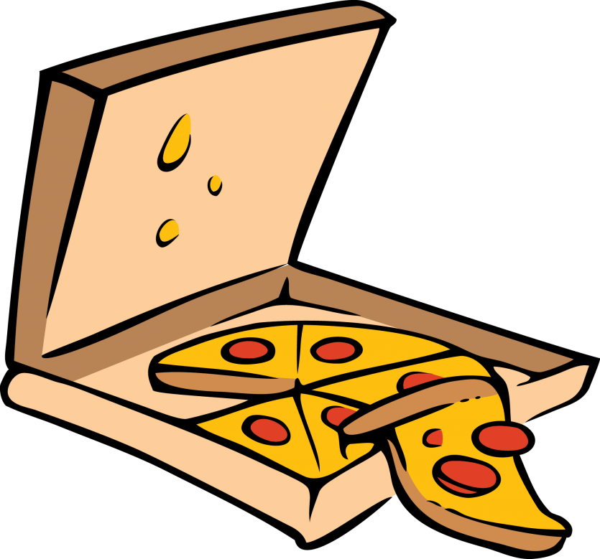
There’s gonna be pizza at the Chen Innovator Talks! 🔥🔥🔥
It’s unlikely there will be pizza at the Chen Innovator Talks!
¯\_(ツ)_/¯

Slide 3
Experienced utility…
at time of news
at time of consumption

Slide 4
Experienced utility…
at time of news
at time of consumption
News Experienced Utility (nEU)
Consumption Experienced Utility (cEU)
nEU

Slide 5
Is experienced utility only influenced by outcomes, or also by beliefs?

Slide 6
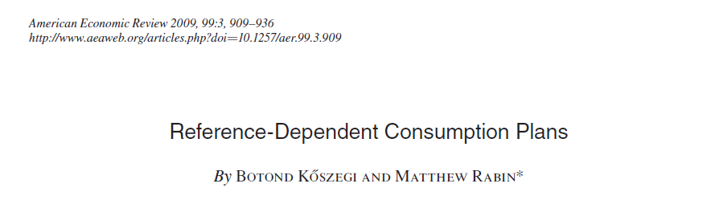
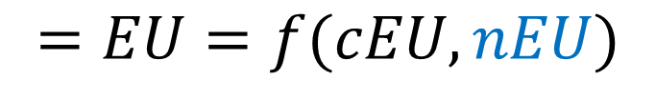
“KR news utility”
$$=EU=f(cEU, nEU)$$
There is a preference for good news NOW about consumption in the future.
Good news can affect experienced utility at the time of consumption.

Slide 7
Hypothesis: Value signals in the OFC incorporate reference-dependent news utility

Slide 8
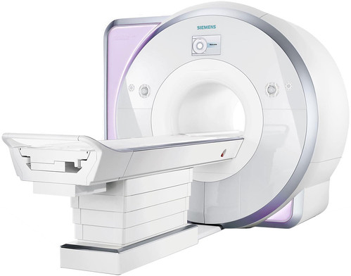

Viewing task
Fractal choice task
Rating task
144 trials
2 blocks
Biological test of KR news utility
24 trials
1 block
Behavioral test of KR news utility
72 trials
1 block
Control variable

Slide 9
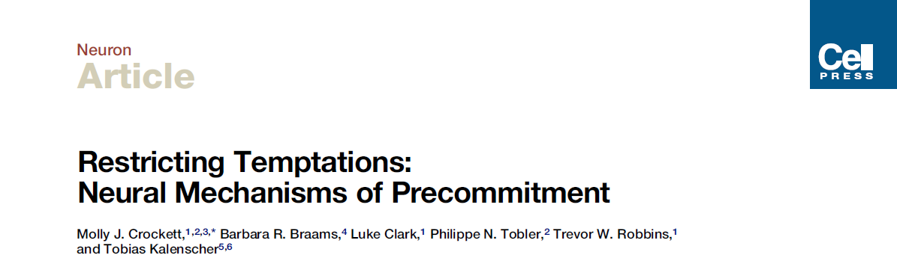
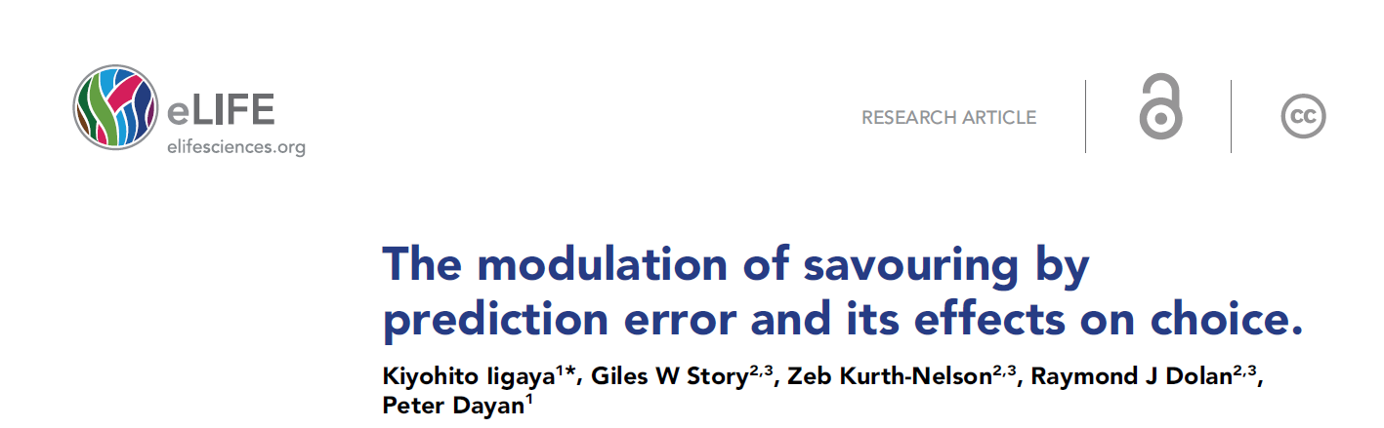
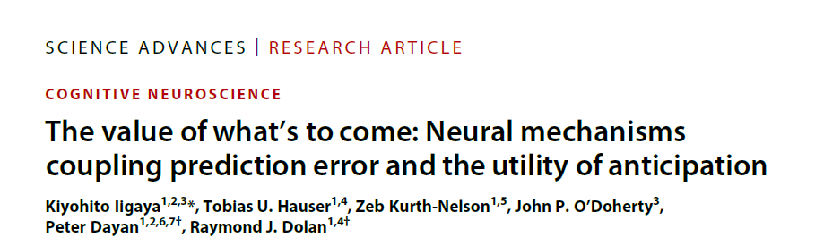
Subjects & Stimulus Set
Heterosexual male subjects.
72 images of women in lingerie.
Crockett et al. (2013), Sescouse et al. (2013), and informal confirmation from Kiyo that heterosexual male vmPFC lights up upon presentation of these types of stimuli.

Slide 10
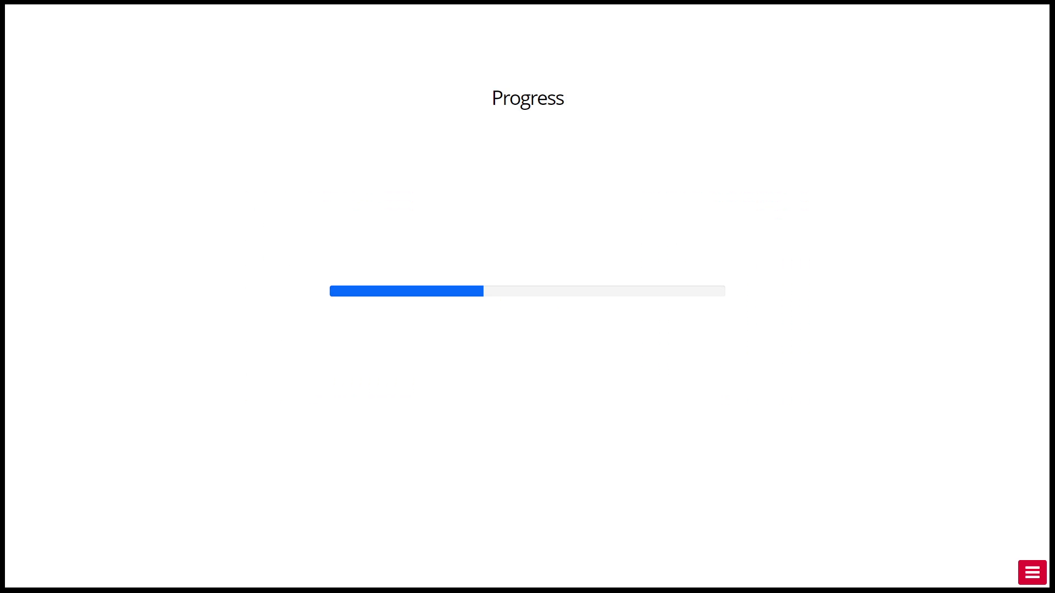
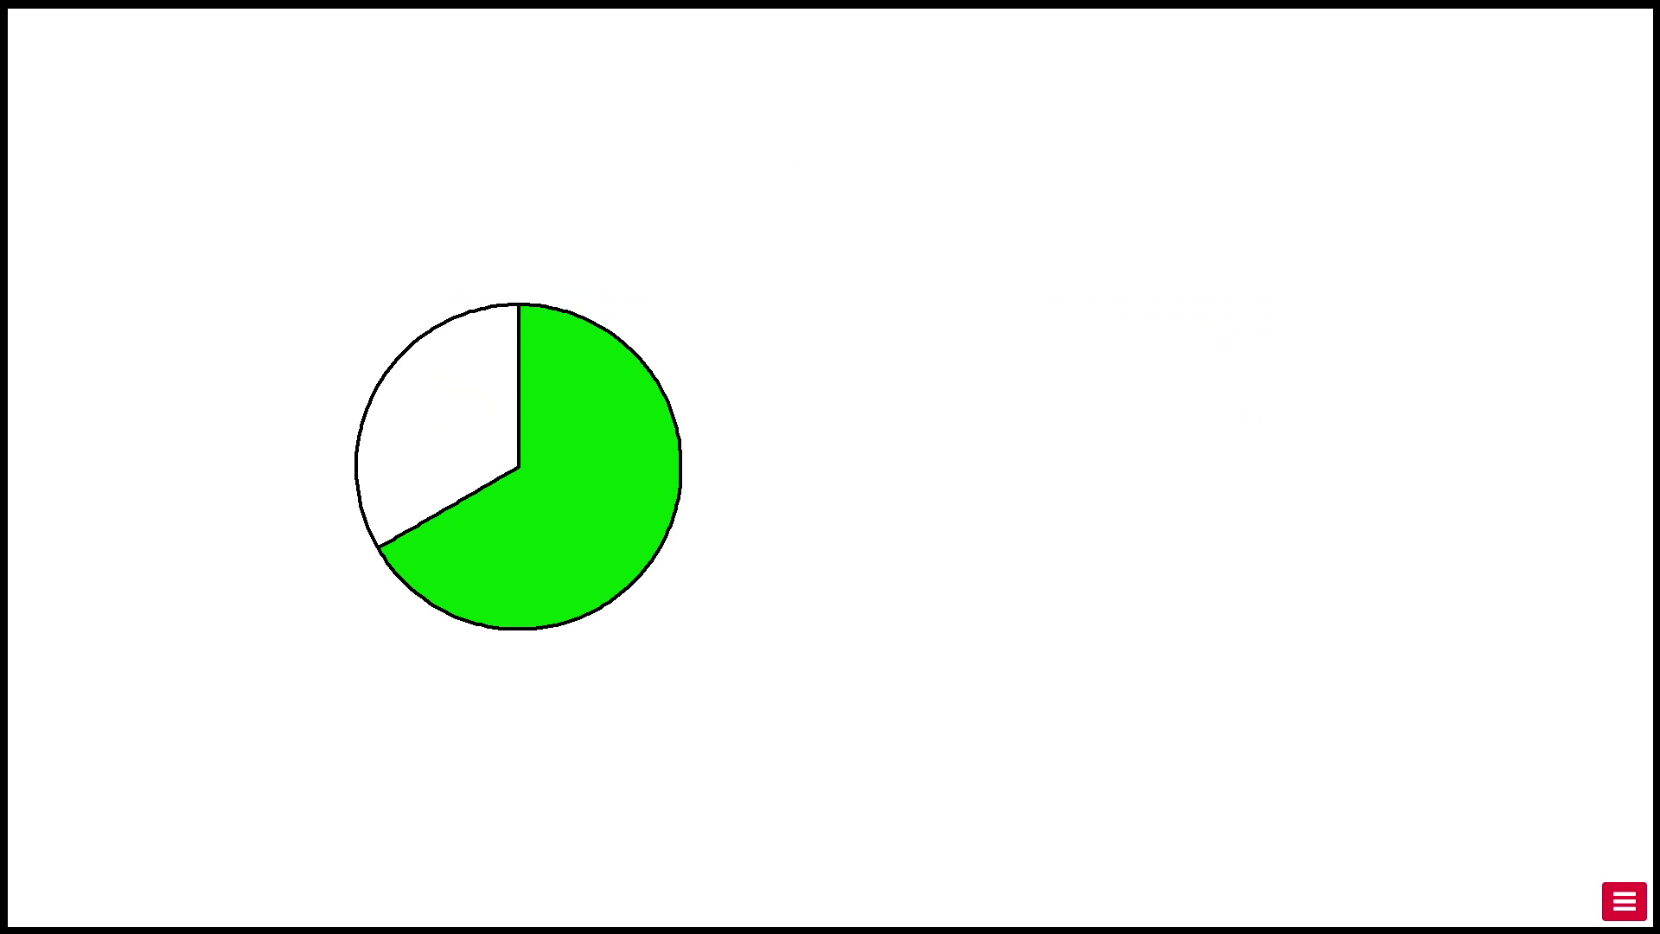
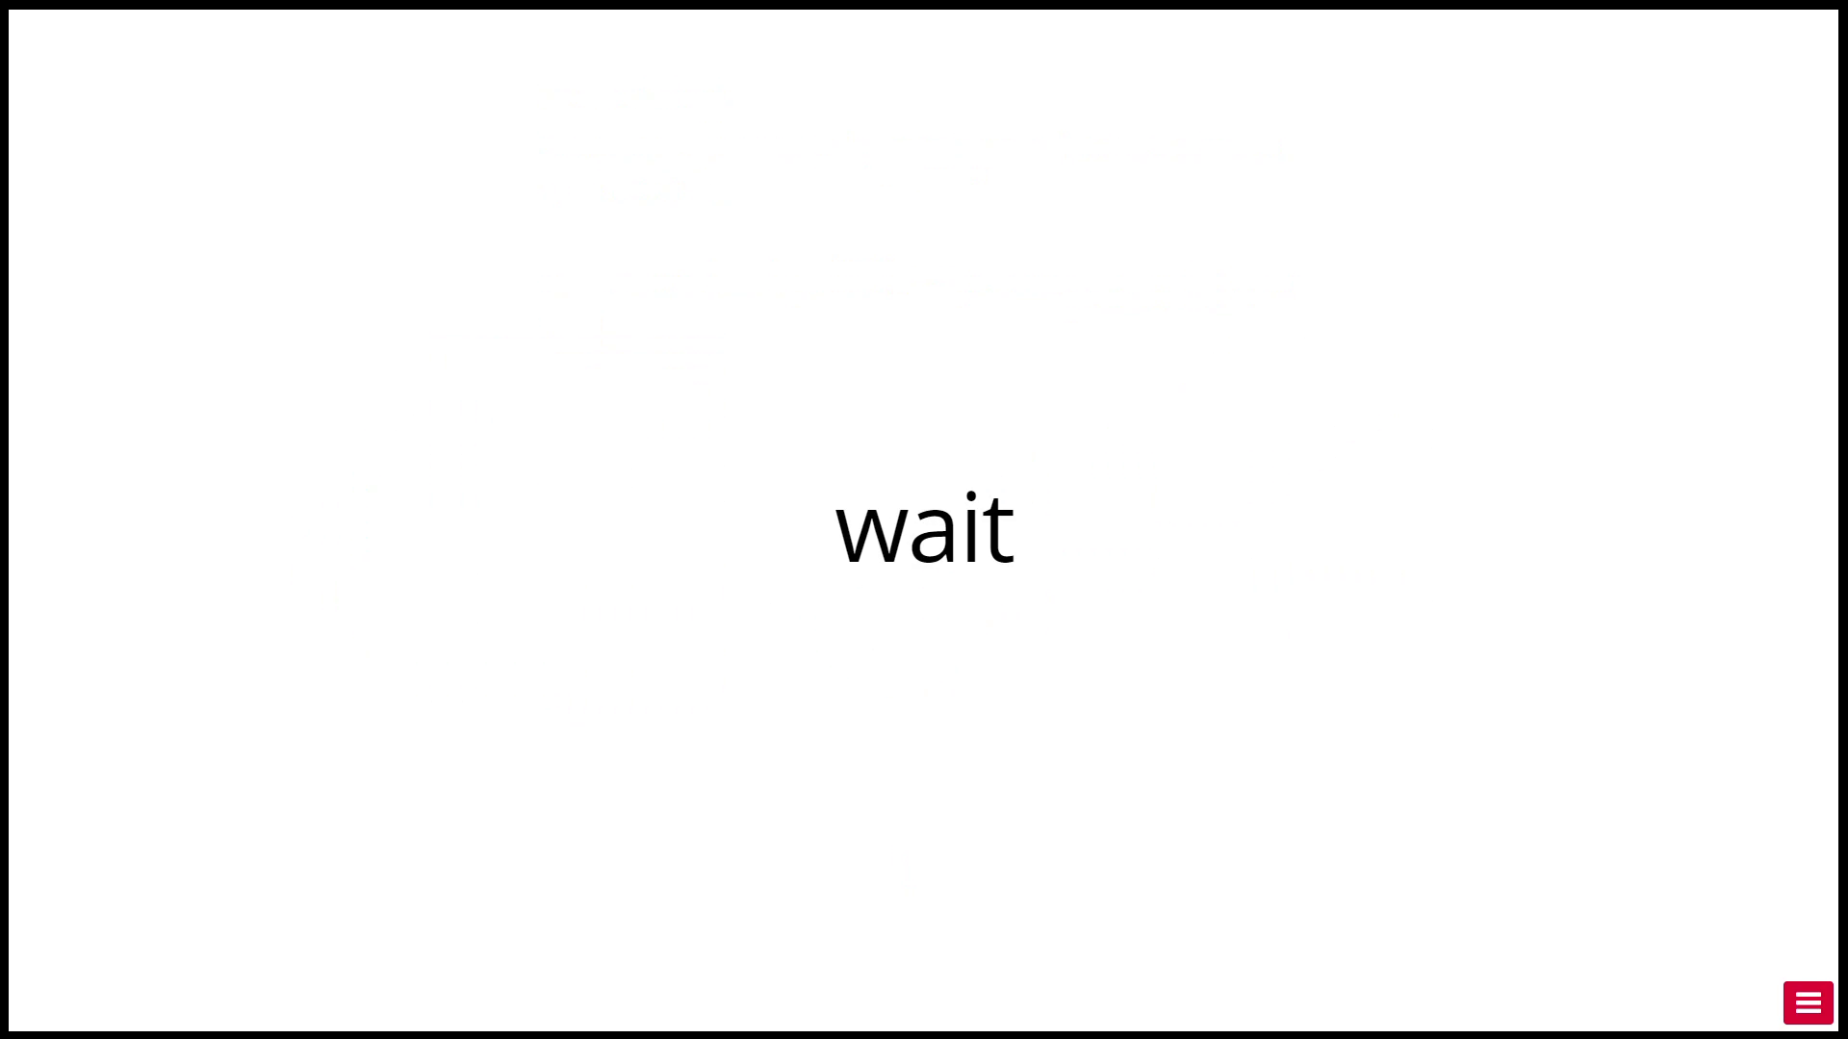
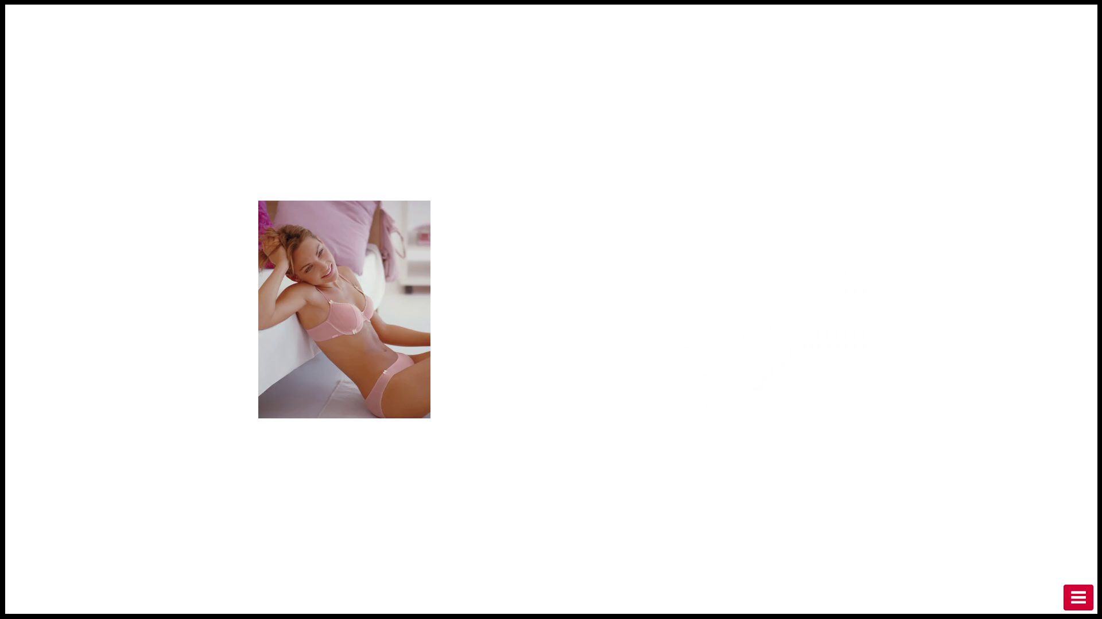


Viewing Task
Progress
Unif(1,5) s
Information
1 s
Wait
{1,2,3,4} s
Outcome
2 s
Feedback
(part of the 2 s)

Slide 11
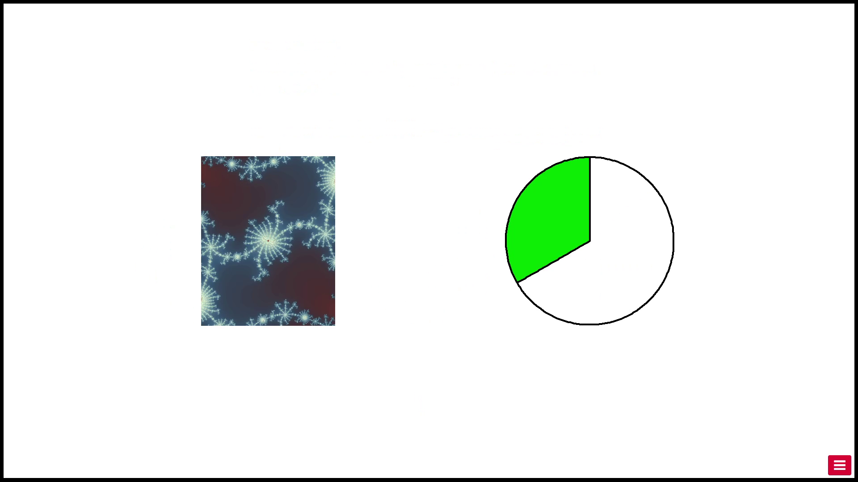
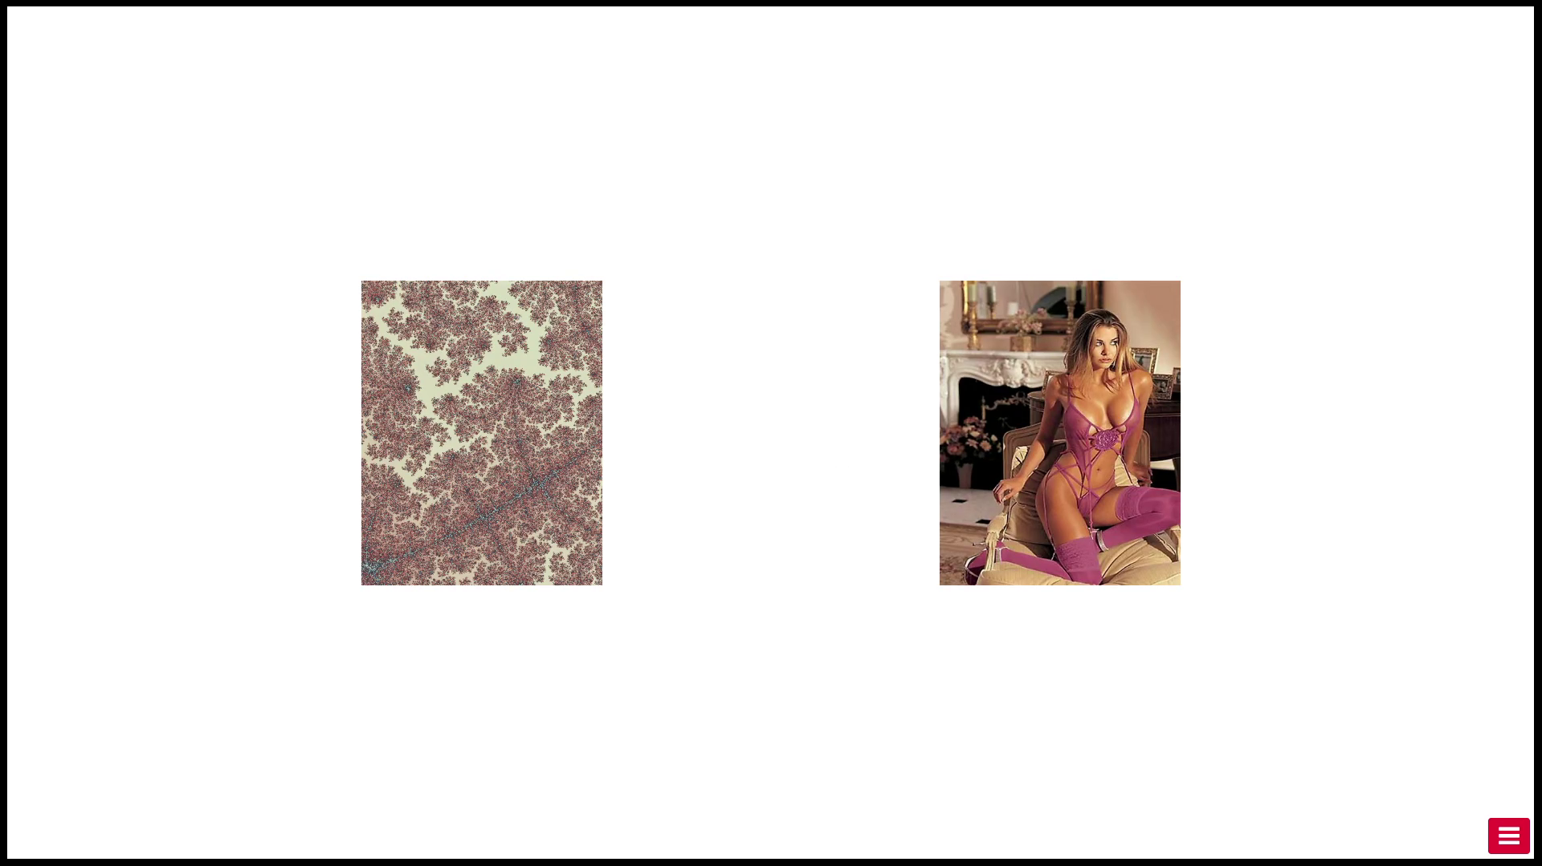
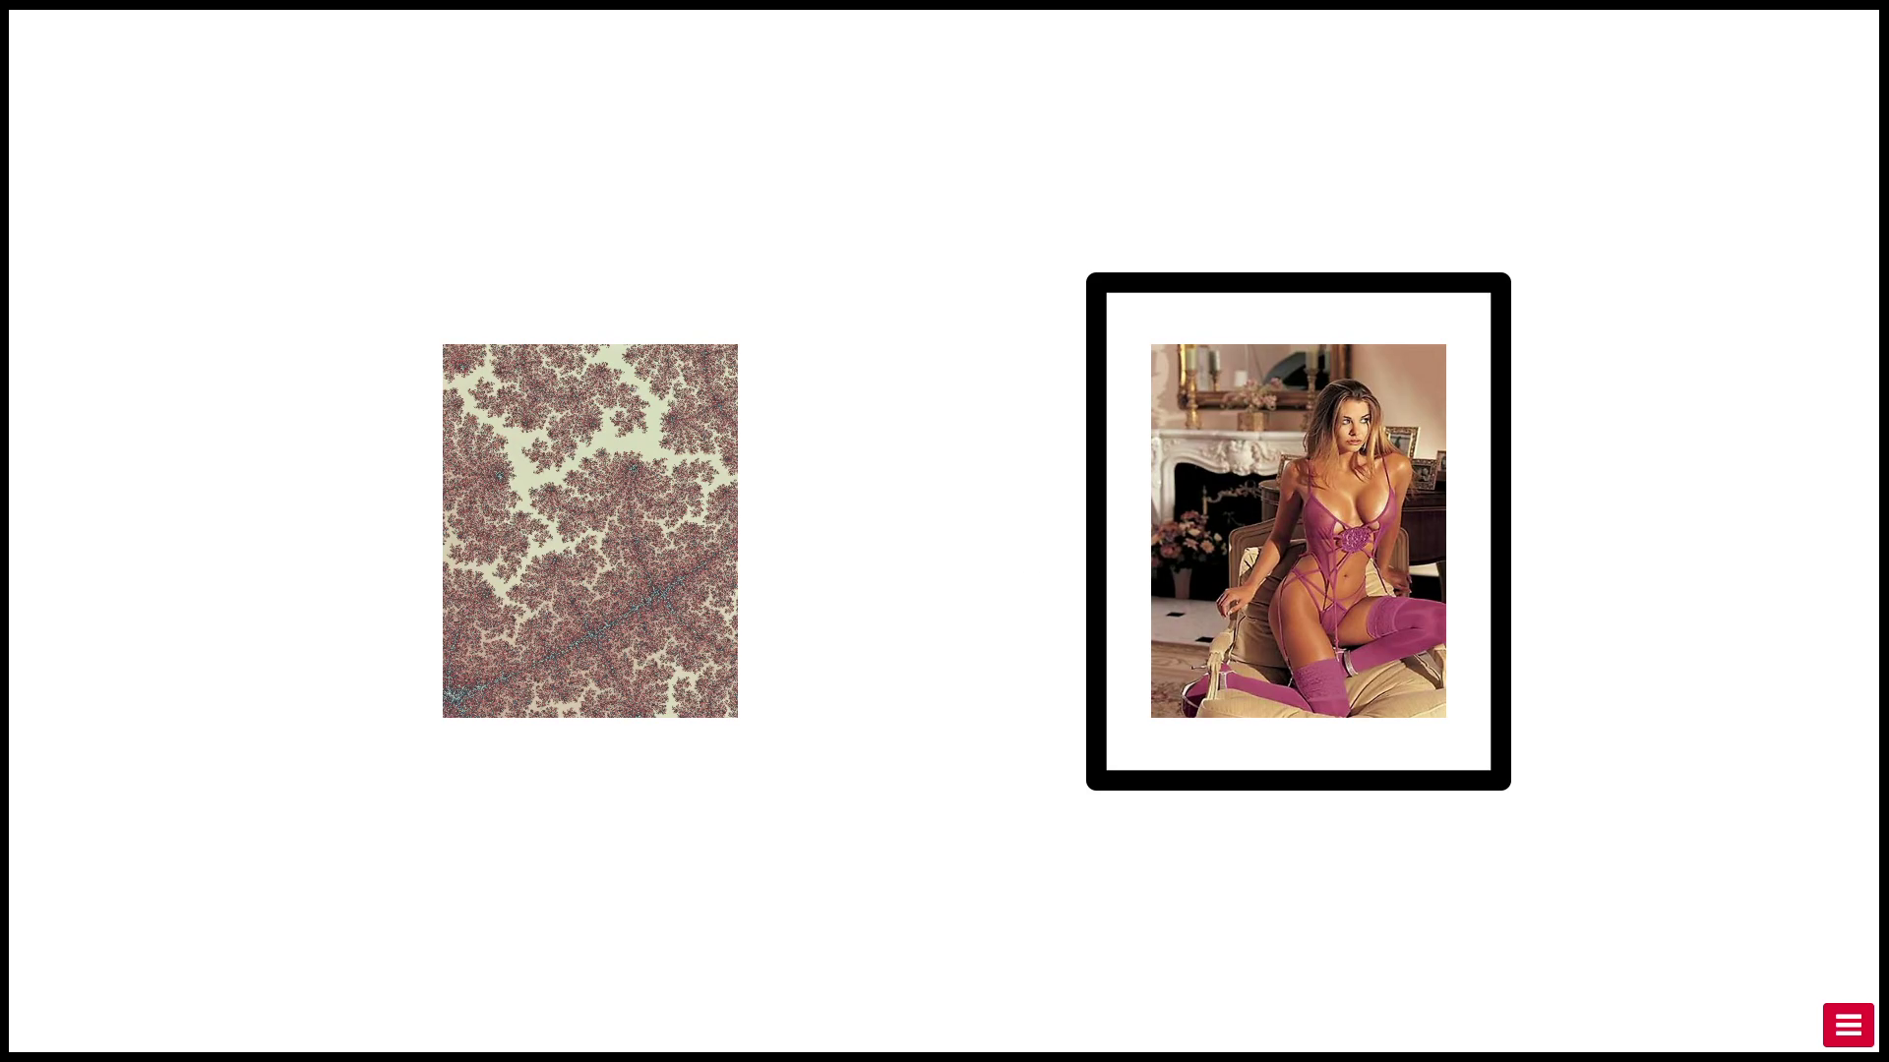
Viewing Task
Progress
Unif(1,5) s
Information
1 s
Wait
{1,2,3,4} s
Outcome
2 s
Feedback
(part of the 2 s)

Slide 12
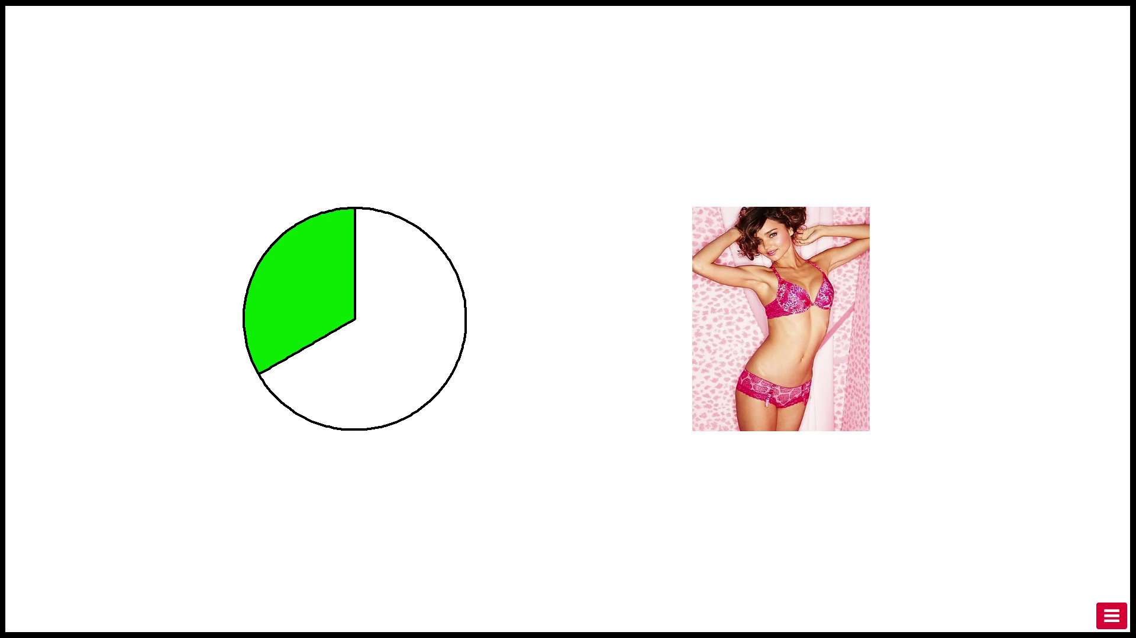
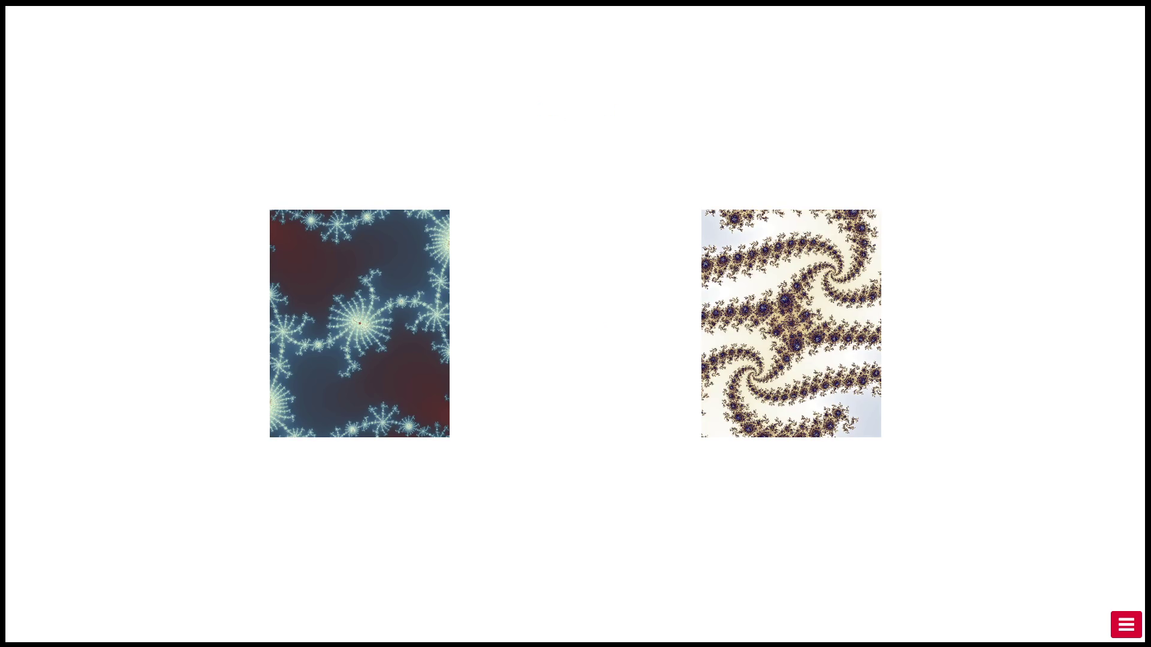
Fractal Choice Task
Progress
1 s
Outcome
2 s
Choice
Free RT
24 times
24 times

Slide 13
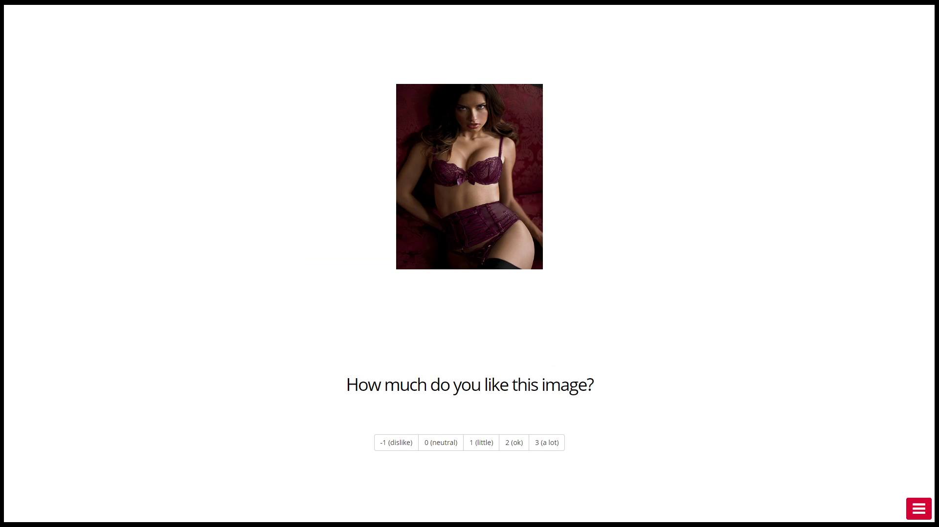
Rating Task
Progress
1 s
Discrete Rating from -1 to 3
Free RT

Slide 14
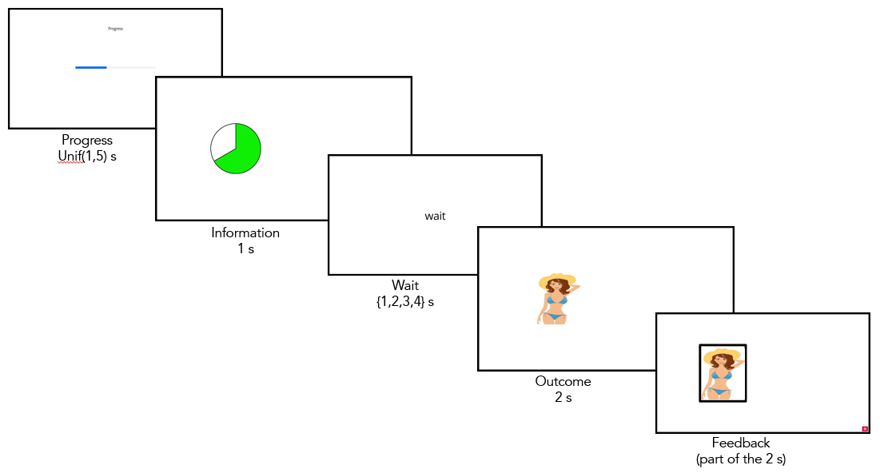
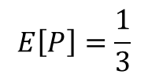
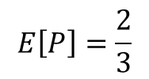
Viewing Task Conditions
Pie Chart | 1 | 2/3 | 1/3 | 0
Block H | ✔ | ✔ | ✔
Block L |  | ✔ | ✔ | ✔
$$E\left[P\right]=\frac{2}{3}$$
$$E\left[P\right]=\frac{1}{3}$$

Slide 15
Viewing Task Conditions
Pie Chart | 1 | 2/3 | 1/3 | 0
Block H | Good News | Neutral News | Bad News
Block L |  | Good News | Neutral News | Bad News

Slide 16
Viewing Task Conditions
Pie Chart | 1 | 2/3 | 1/3 | 0
Block H | Good News | Neutral News | Bad News
Block L |  | Good News | Neutral News | Bad News

Slide 17
Viewing Task Conditions
Pie Chart | 1 | 2/3 | 1/3 | 0
Block H | Good News | Neutral News | Bad News
Block L |  | Good News | Neutral News | Bad News

Slide 18
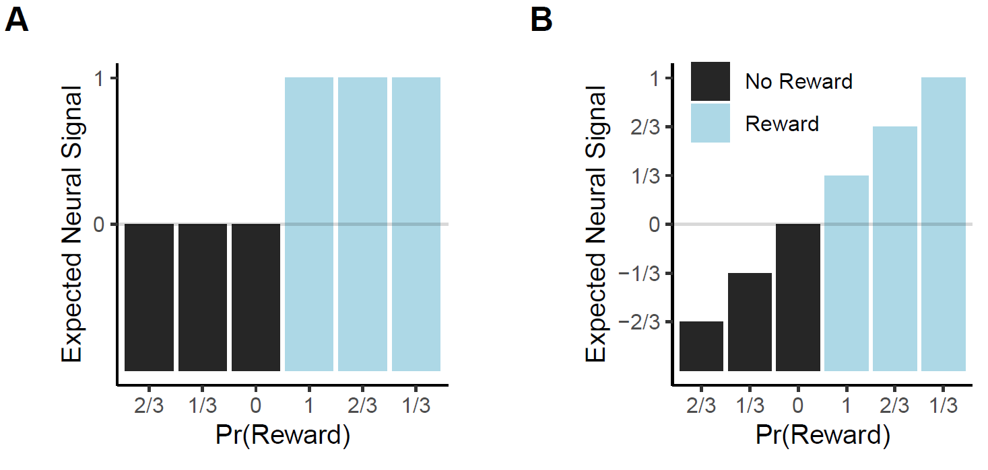
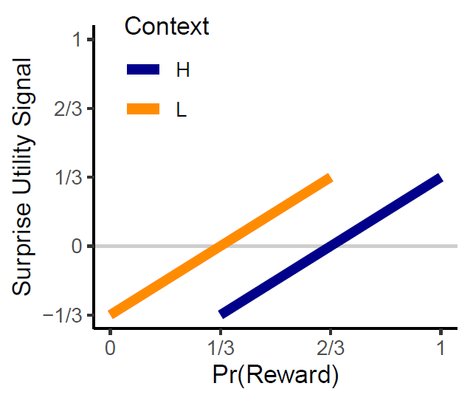
Expected BOLD signal in OFC at time of news

Slide 19
Expected BOLD signal in OFC at time of consumption

Slide 20
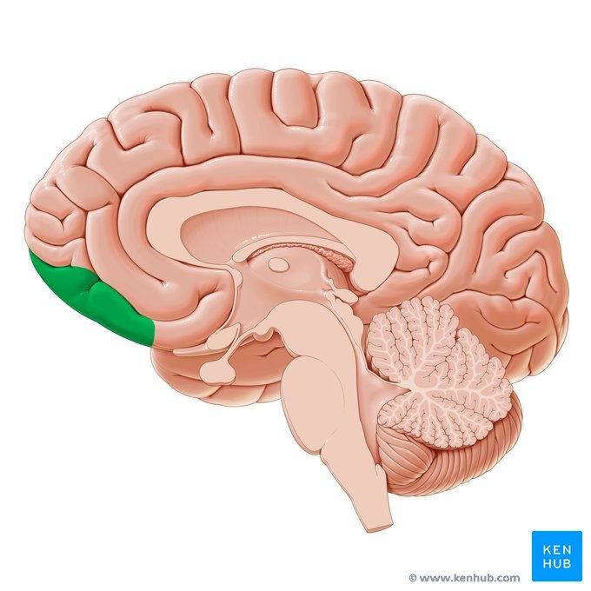
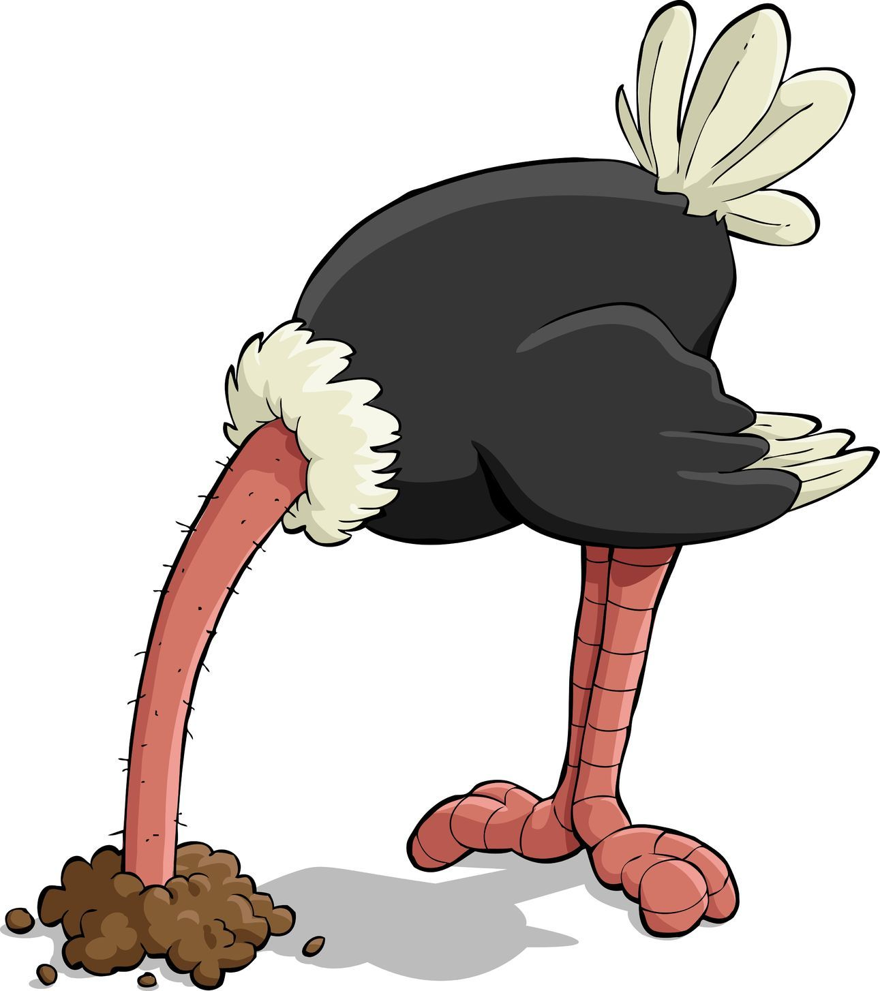


Conclusion
Experienced Utility = Consumption + Beliefs
at time of news
at time of consumption

